Slide 1
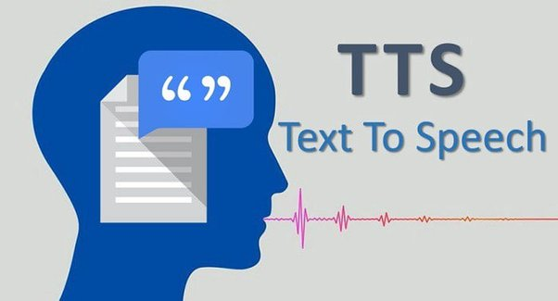
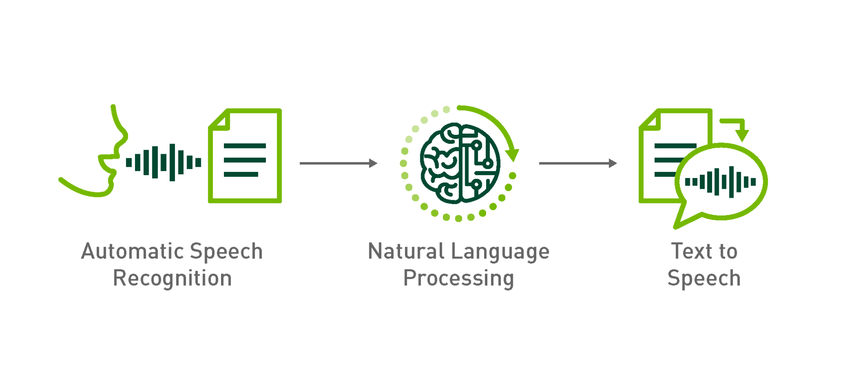
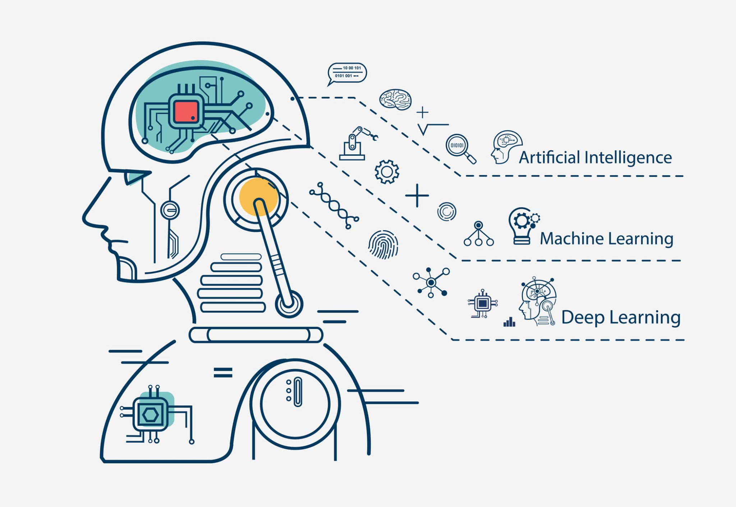
Mentor Karanjot Singh
Text-to-speech (TTS)
Team
Jobanpreet Singh
Jashneet Kaur

Slide 2
Text-to-Speech
Text-to-Speech or Speech Synthesis is a system that takes text as input and generates an audio signal from it. Deep learning TTS consists of three
essential components:
A text analysis module
An acoustic model and
A vocoder
The text analysis module converts text sequence into linguistic features.
Linguistic features such as phonemes, prosody and linguistic context.
The acoustic model generated acoustic acoustic features from linguistic features. Acoustic features such as pitch contour, duration information and spectral characteristics.
Finally, the vocoder synthesis a waveform from those acoustic features.

Slide 3
Goal of our Project
We’ll be working on Four Acoustic models:
Tacotron 2
FastSpeech 2
VITS
JETS/GlowTTS/Vakyansh-tts

Slide 4
Why we opted these architectures ?
1. The previous rule based approaches such as Concatenative method, Statistical Parametric Speech Synthesis does not give natural sound. The speech was robotic.
2. We have to develop set of rule which needs a linguistic knowledge related to that language.
3. Concatenative systems can require a substantial amount of storage space for storing speech units, especially for high-quality voices with large databases.
4.Already available system faces issues such as less intelligible and not robust(Skipping or repeating word), slow inference speed.
5. Moreover, limited work is done over low resource languages such as Punjabi, Hindi and other indic languages.

Slide 5
Tacotron 2
A Neural Network architecture for Text-to-speech:
Recurrent Sequence-to-sequence : Network with attention predicts sequence of mel spectrogram frames from input character sequence.
Modified Wavenet : Generates Time-Domain waveform samples on predicted mel spectrogram frames.
What’s wrong with WaveNet…?
Wavenet was introduced by Google Deepmind in 2016, which was used to generate the voice in Google Assistant . So, what was problem with Wavenet.?

Slide 6
Input requires linguistic features, fundamental frequencies and phonemes duration and all of this require significant Domain knowledge to interpret and process.
Tacotron(2017) which polish the problem with sequence to sequence architecture where the input character sequence were transformed into magnitude spectrograms, this eliminated the problem of complex linguistic and acoustic input features and now we can use raw data.
In original Tacotron, the Spectrograms were passed into vocoder which uses Griff-Lim algorithm for speech synthesis. So, Replacing Griff-Lim algorithm with wavenet like vocoder in Tacotron and now google come up with Tacotron 2.
Tacotron + Wavenet Vocoder - Griff-Lim = Tacotron2

Slide 7
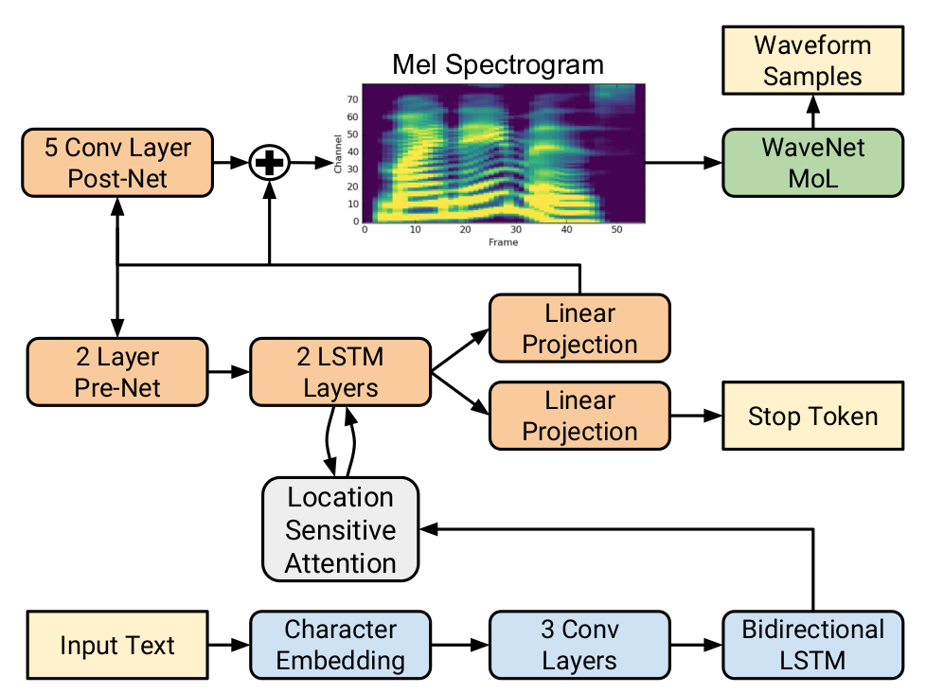

Slide 8
Network: (LSTM & CNN Layers) Convert character sequence into melspectrogram.
Modified Wavenet : Convert mel spectrogram into speech.
Why mel spectrogram as intermediate..?
Mel spectrogram are designed to mimic this logarithmic scale and are better suited for capturing the way humans perceive pitch and intensity variations in speech.
Mel spectrograms have lower dimensionality compared to raw audio waveforms which helps in reducing time complexity , making training and inference more efficient.
It emphasis the recognition of low frequency sounds over bursts of high frequency auditory signals.
It provides more stable and well-defined representation of phonetic content, making it easier for model to learn alignments between input text and target speech.
Despite lossy information it is still possible to generate high quality audio using mel spectrogram and modified wavenet.

Slide 9
Two Main components of Tacotron 2
Tacotron 2 like predecessor uses STFT to compute mel spectrograms . This network consists :
Encoder : The encoder takes input text and processes it into fixed-length context vector . This vector contains information about linguistic content and prosody of input text. It is implemented using RNN & LSTM.
Decoder with Attention Mechanism : The decoder generates the mel spectrogram which represents the speech’s spectral content over time . Tacotron 2 uses attention mechanism in decoder , it helps the model to focuses on different parts of input text while generating each frame of the mel spectrogram . It is often implemented using RNN & CNN to predict mel spectrogram frame by frame .
These two components work together to convert the input text into sequence of mel spectrogram frames, which can be further processed to generate the final waveform producing natural sounding speech.
.

Slide 10
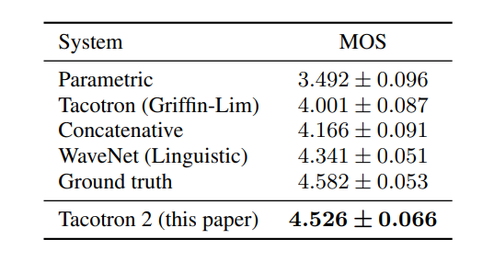
.
Evaluation Score

Slide 11
FastSpeech2
FastSpeech2 is a non-autoregressive model which synthesize speech faster than a previous auto-regressive models such as Tacotron2, Deep Voice1/2.
Let’s understand some basic terminologies before diving into architecture:
Autoregressive models: TTS model, which generate speech one audio sample at a time in sequential manner.
Non-Autoregressive models: TTS model , which generate speech in faster and parallel.
Benefits of Non-Autoregressive over Autoregressive models:
Parallel Generation
Reduced latency
Training Efficiency
Potential for end-to-end models

Slide 12
The training of FastSpeech model relies on an autoregressive teacher model for duration prediction (to provide more information as input) and knowledge distillation which can ease the one-to-many mapping problem (i.e., multiple speech variations correspond to the same text) in TTS.
What is Autoregressive teacher model?
Autoregressive teacher model predicts the duration of individual phonemes or sub-words units in the input text.
What is Autoregressive generation?
Phonem/Duration Prediction
for example:
Input text is Hello world , its phonetic representation is HH AH L OW . W ER L D .
The autoregressive teacher model starts by taking the first phoneme HH . It predicts the duration how long HH should be spoken and geneartes the corresponding audio representation for HH.

Slide 13
Knowledge Distillation
Knowledge distillation is a technique used in machine learning to transfer knowledge from one model (the teacher) to another model (the student) in order to improve the student model's performance.
Disadvantages of FastSpeech
1.The teacher-student distillation pipeline is complicated and Time-consuming.
2.The duration extracted from the teacher model is not accurate enough, and the target mel-spectrograms distilled from teacher model suffer from information loss due to data simplification, both of which limit the voice quality.

Slide 14
FastSpeech2
1.Directly training the model with ground-truth target instead of the simplified output from teacher
2.Introducing more variation information of speech (e.g., pitch, energy and more accurate duration) as conditional inputs.
Architecture of FastSpeech2
The encoder converts the phoneme embedding sequence into the phoneme hidden sequence, and then the variance adaptor adds different variance information such as duration, pitch and energy into the hidden sequence, finally the mel-spectrogram decoder converts the adapted hidden sequence into mel-spectrogram sequence in parallel.

Slide 15
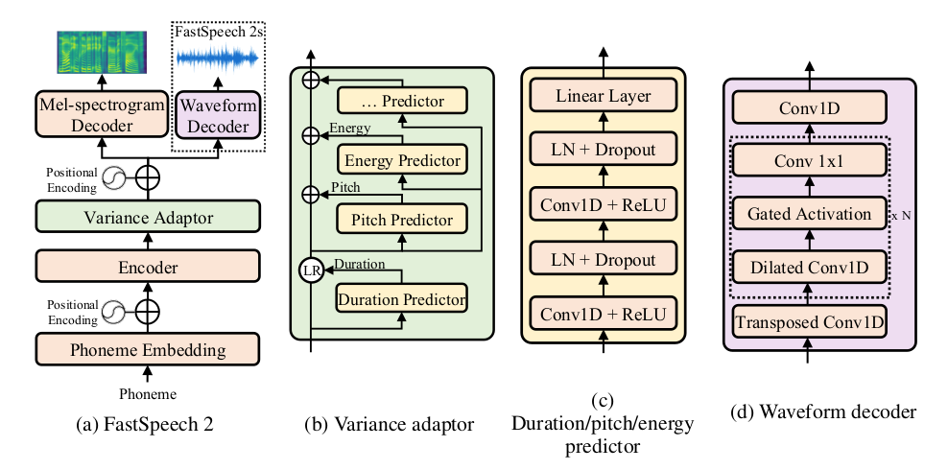

Slide 16
Variance adaptor
It adds variance information, including duration, pitch, and energy, to the hidden sequence generated by the encoder.
Duration predictor
The duration predictor uses phoneme durations obtained through forced alignment (a technique for aligning phonemes with audio) as training targets. This is found to be more accurate than using durations extracted from the attention map of an autoregressive teacher model.
Pitch predictor and Energy predictor
Pitch and energy predictors provide additional variance information, which helps address the one-to-many mapping problem in TTS by allowing the model to capture different prosodic variations.

Slide 17
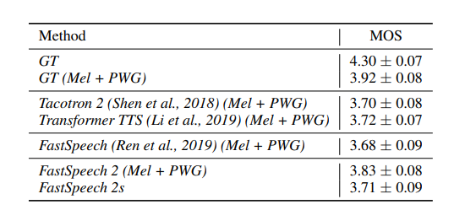
Evaluation Score
.

Slide 18
What we have done upto now?
We have trained the 5 hours of Punjabi data on FastSpeech2 architecture. Dataset is taken from IIT Madras site:
Go to Dataset
Open Source FastSpeech2 code repository
Go to Repository
System Configuration
Ubuntu 22.04
NVIDIA RTX A5000 24GB

Slide 19
Steps to train the model from scratch
1. Clone github repository and install dependencies mentioned in requirements.txt file
Command -> pip3 install -r requirements.txt
2. Put folder of dataset with audio files in wav folder and corresponding transcriptions in .csv or .txt file. Audio files should be in .wav format and sampling rate =22KHz
3. Run command -> python3 prepare_align.py config/LJSpeech/preprocess.yaml
This command with generate .lab files and preprocessed audio files. These are used to train the acoustic model and to generate the alignments.
Alignments can be generated using Montreal Forced Aligner tool. Alignments will be in the form of .textgrid files have duration of each word and phoneme as well as their corresponding transcription.
Command-> mfa align ./montreal-forced-aligner/bin/mfa_align raw_data/LJSpeech/ lexicon/librispeech-lexicon.txt english preprocessed_data/LJSpeech

Slide 20
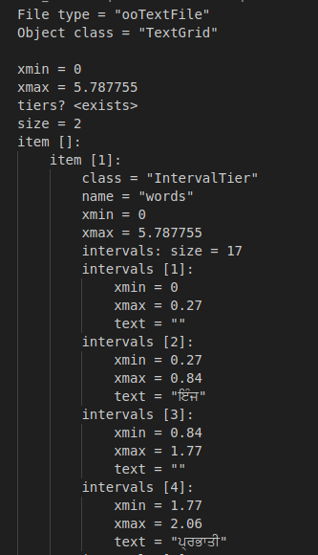
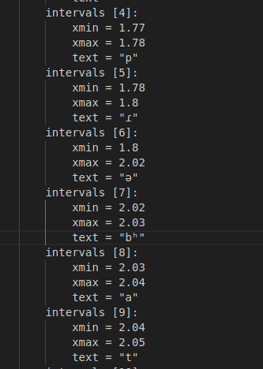

Slide 21
5. After the TextGrid files are generated run command ->python3 preprocess.py config/LJSpeech/preprocess.yaml
This command will generate pitch ,duration,energy and melspectrogram durations in the form of numpy array.
At last we run the training command-> python3 train.py -p config/LJSpeech/preprocess.yaml -m config/LJSpeech/model.yaml -t config/LJSpeech/train.yaml
Training over 5 hours of data took more than 40 hours . Resulting speech was not that much natural and robust due to less training data. FastSpeech2 is a transformer based model and accuracy improves as we increase data.

Slide 22

ਪਟਿਆਲੇ ਯੂਨੀਵਰਸਿਟੀ

Slide 23
ਡਾਕਟਰ ਬੜਾ ਖੁਸ਼ ਹੋਇਆ

Slide 24
ਫਿਲਮ ਕੇ ਬਾਰੇ ਮੇਂ ਬਾਤ ਕਰਨੀ ਹੈ

